Slide 1
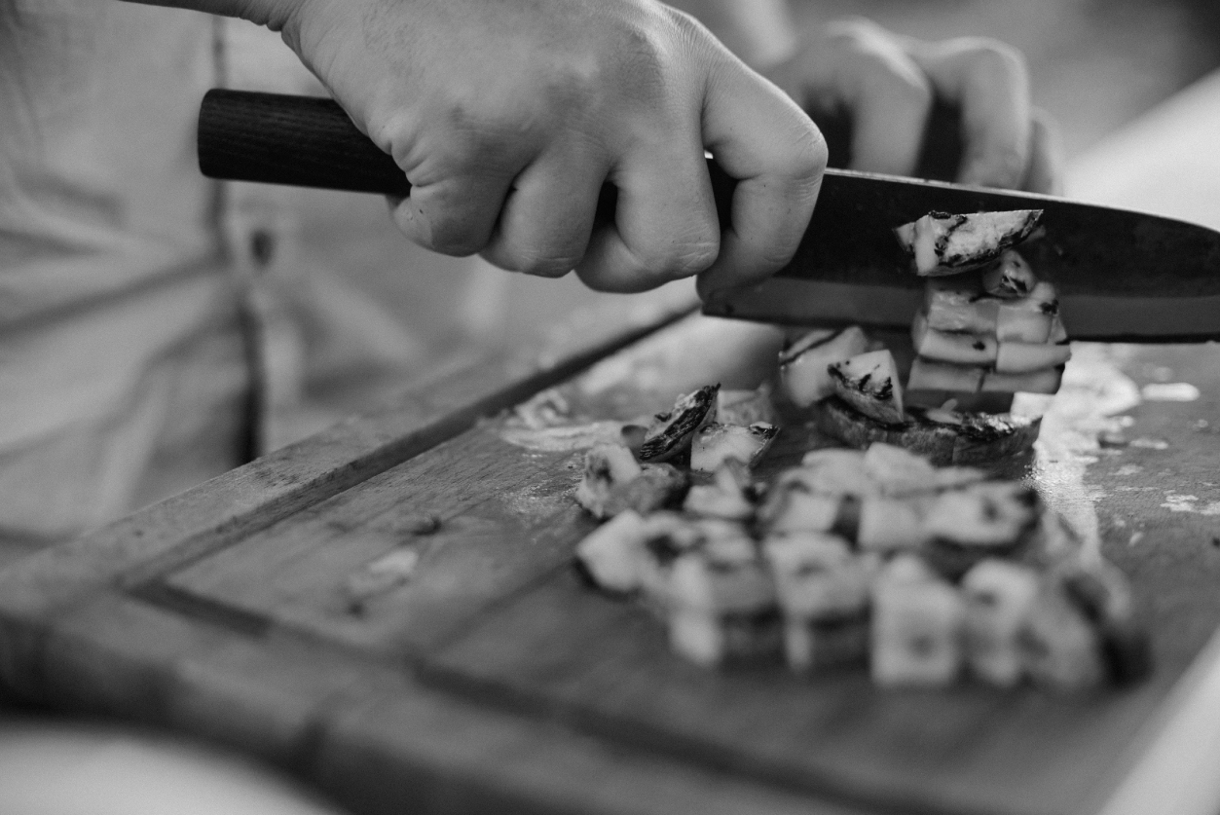
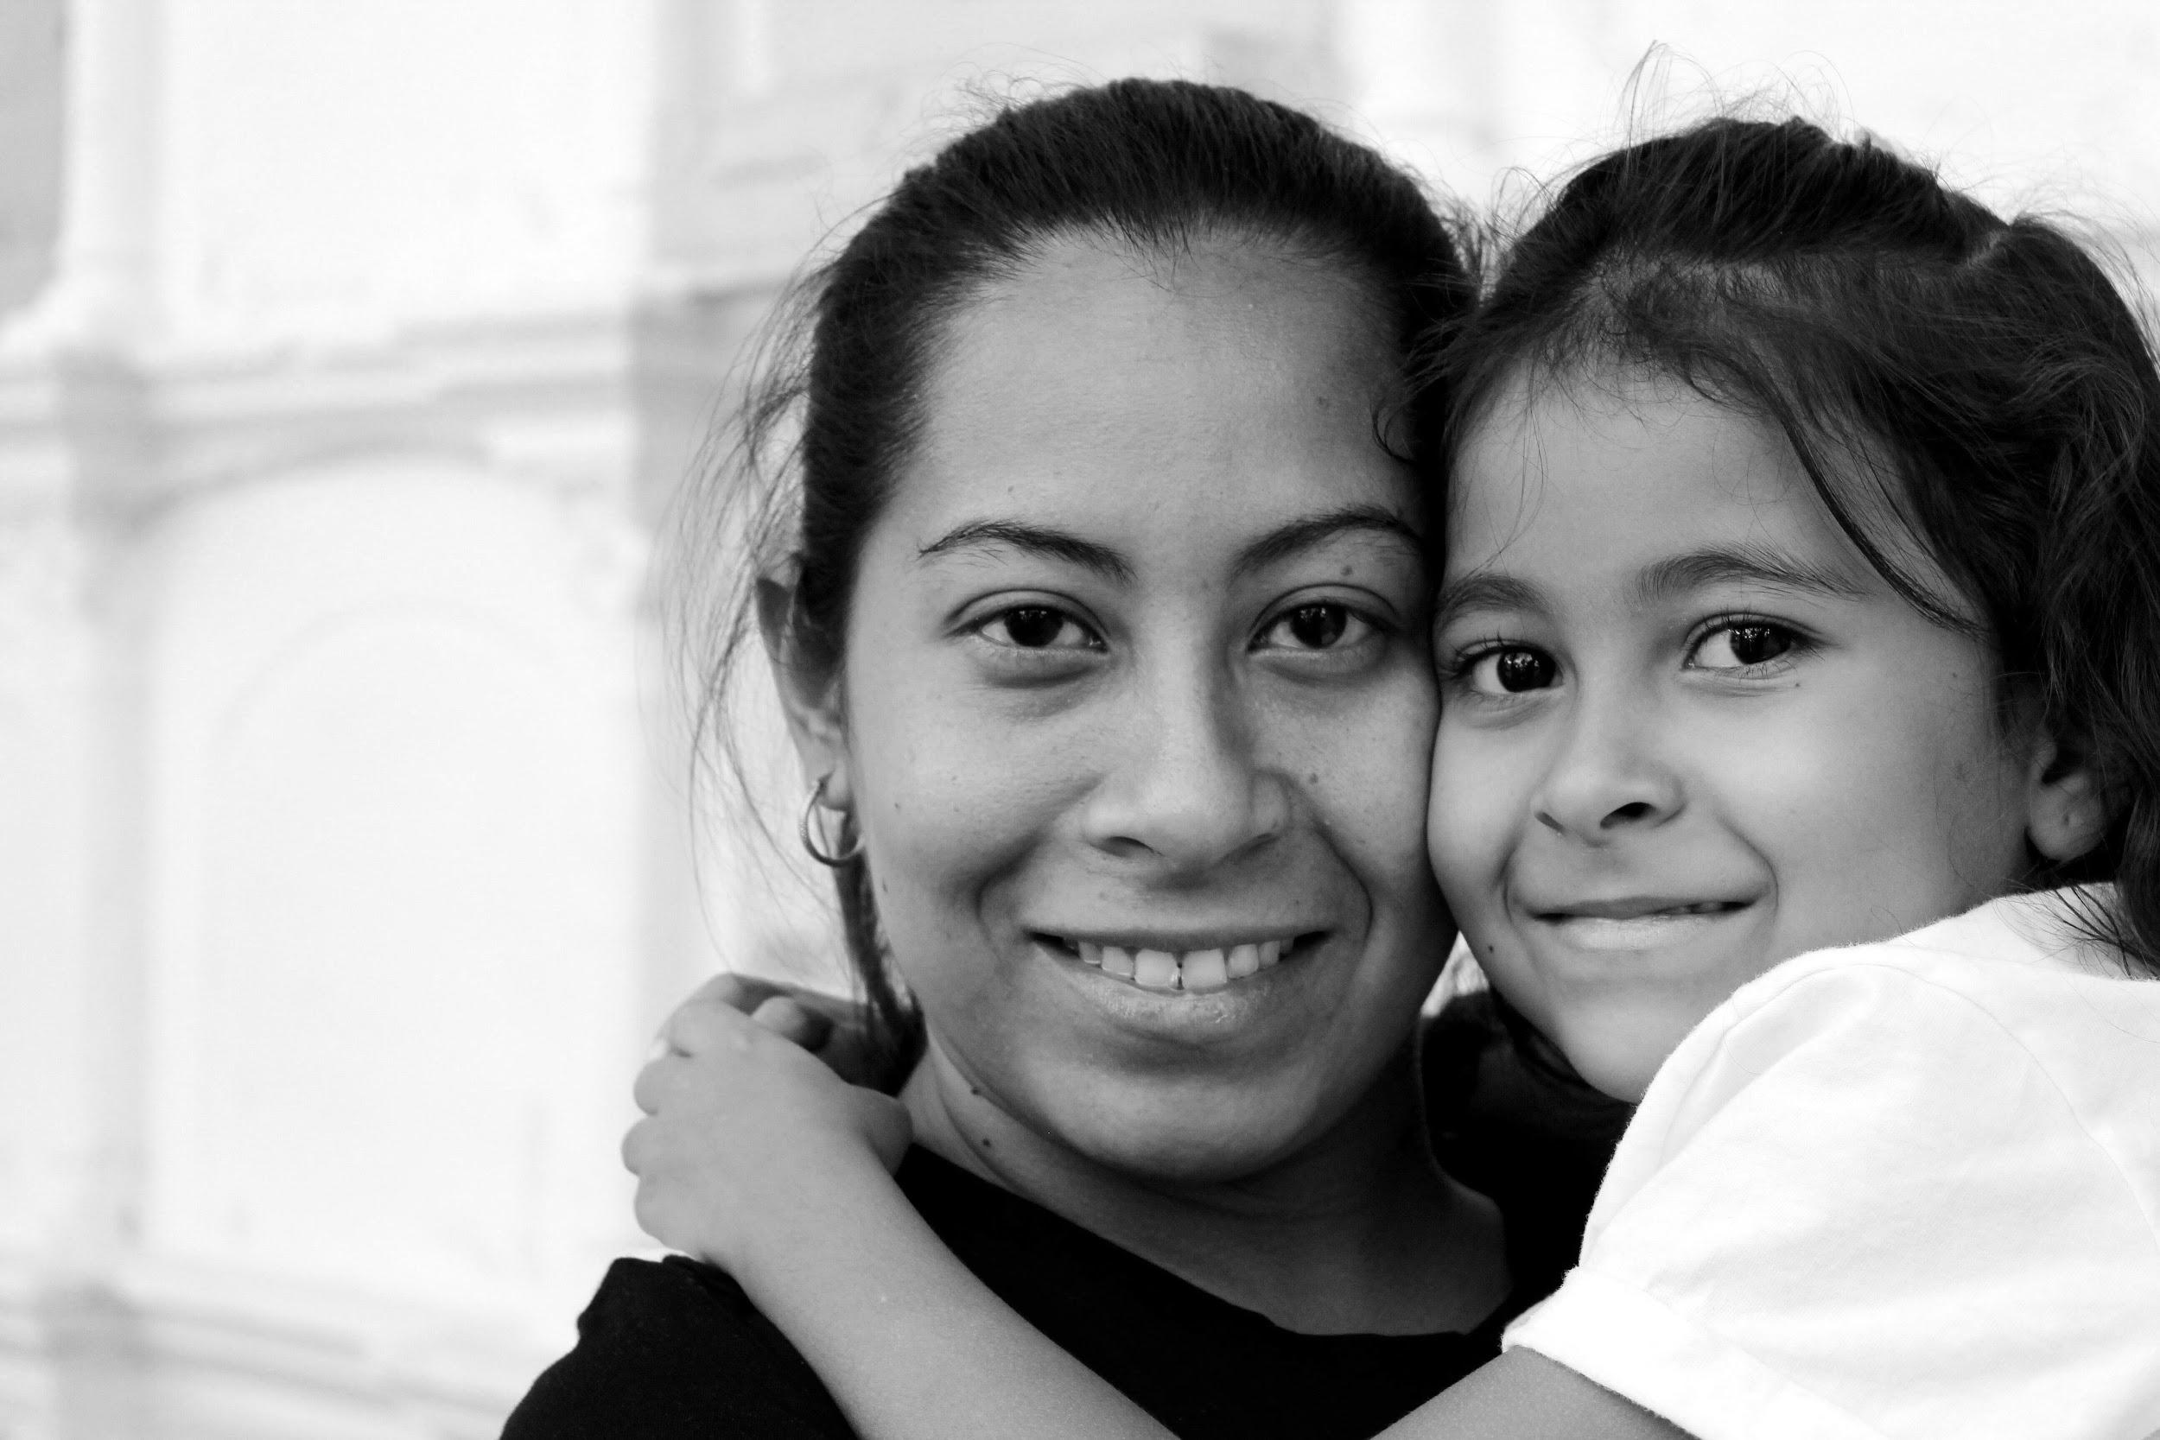
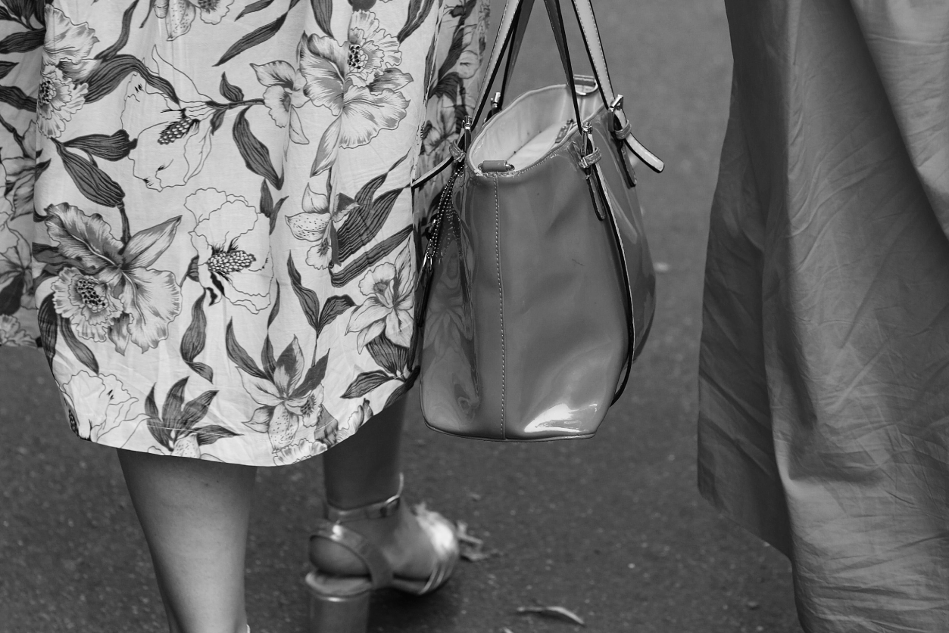
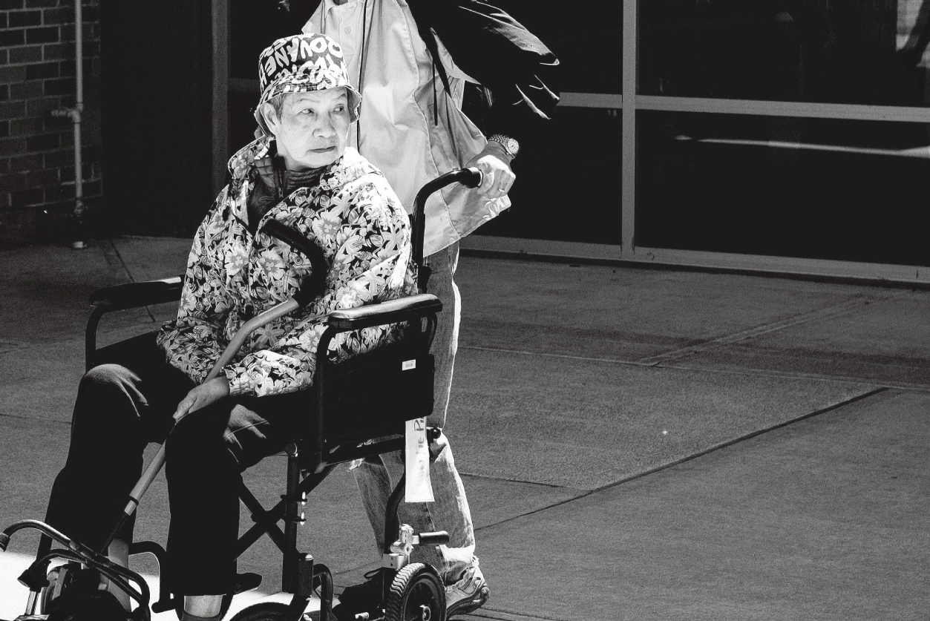
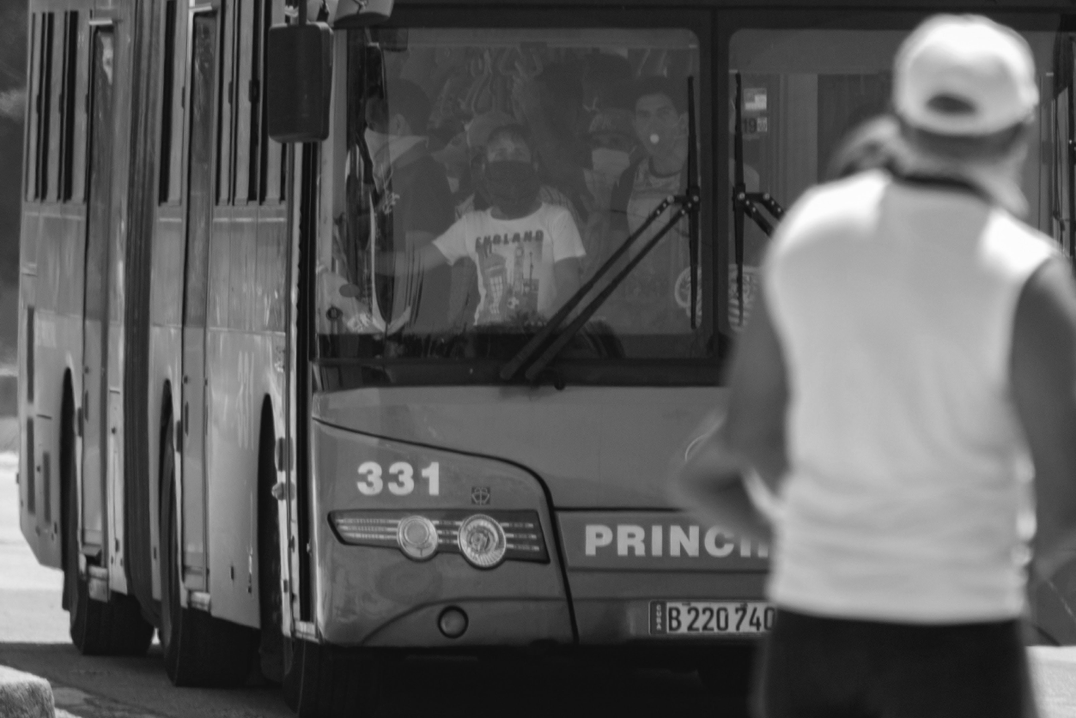
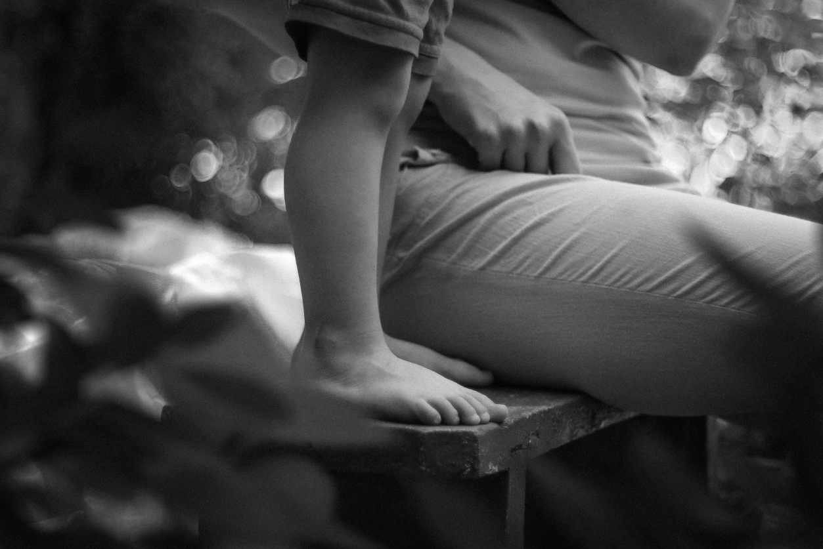

Slide 2
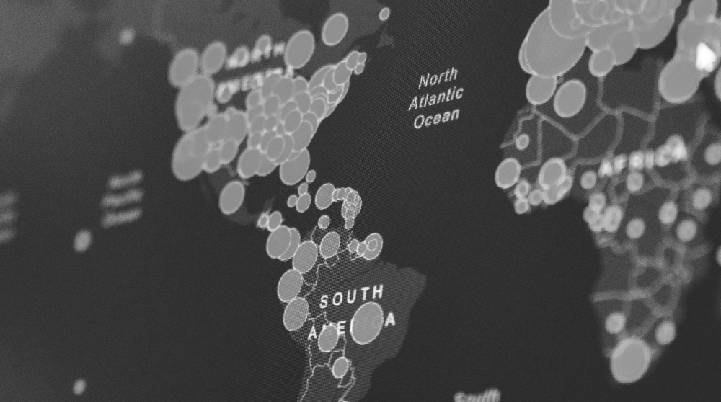
-viral load
-antiboides
- Flow Cytometry

Slide 3
*
*
*
**
* WorldoMeters
** Asian Development Bank
Notes:
*Asian Development Bank (Economical impact)
https://www.adb.org//news/covid-19-economic-impact-could-reach-8-8-trillion-globally-new-adb-report
* Total cases, recovered, deaths
https://www.worldometers.info/coronavirus/

Slide 4

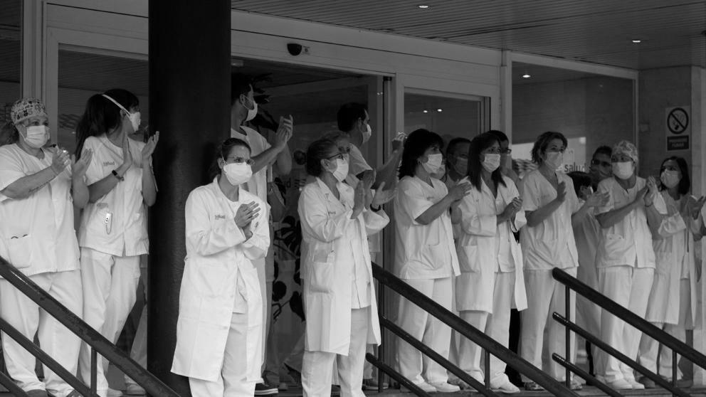
“The true warrior isn’t immune to fear. She fights in spite of it”
Francesa Lia Block

Slide 5


Slide 12
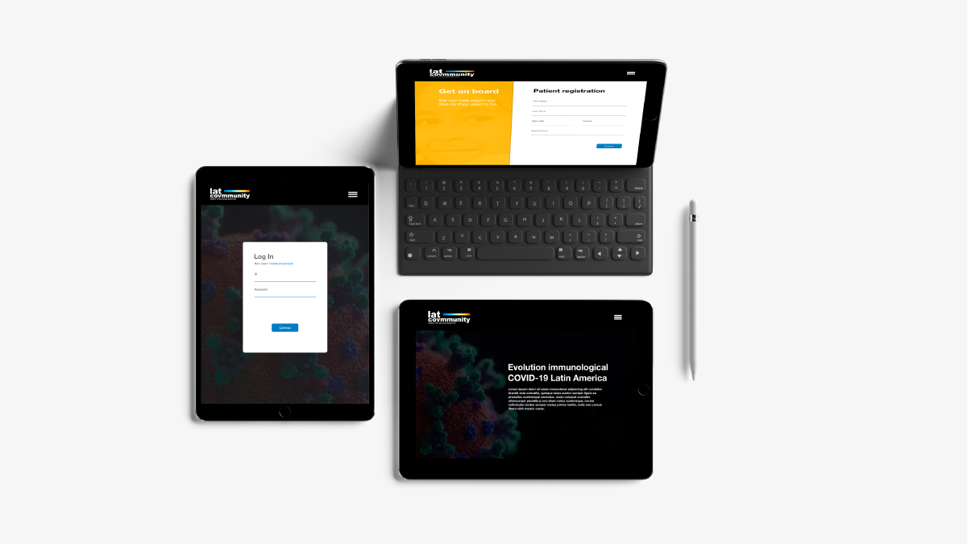

Slide 13
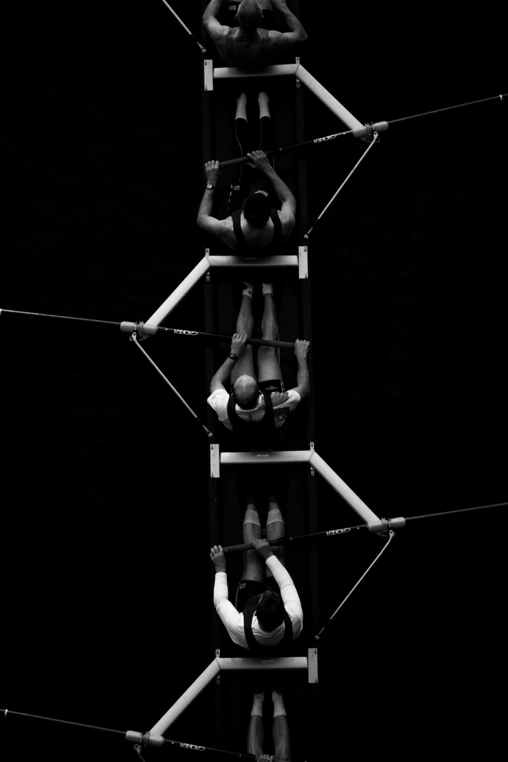

Slide 14

latcovmmunity.com

Slide 15
References
Grifoni, A., Weiskopf, D., Ramírez, S., Mateus, J., Rydyznski, C., Rawlings, S., Sutherland, A., Premkumar, L., Jadi, R.,
Marrama, D., de Silva, A., Frazier, A., Carlin, A., Greenbaum, J., Peters, B., Krammer, F., Smith, D., Crotty, S., Sette, A. (2020), Targets of T Cell Responses to SARS-CoV-2 Coronavirus in Humans with COVID-19 Disease and Unexposed Individuals, Cell [online]. Available from: https://www.cell.com/cell/fulltext/S0092-8674(20)30610-3 [Accessed 20 June 2020].
Kirkcaldy, R., King, B., Brooks, J. (2020), COVID-19 and Postinfection Immunity, Jama Network [online]. Available from:
https://jamanetwork.com/journals/jama/fullarticle/2766097 [Accessed 20 June 2020].
Chandrashekar, A., Liu, J., Martinot, A., McMahan, K., Mercado, N. (2020), SARS-CoV-2 infection protects against rechallenge in rhesus
macaques, American Association For The Advancement Of Science [online]. Available from: https://science.sciencemag.org/content/early/2020/05/19/science.abc4776 [Accessed 20 June 2020].
Weitz, J., Beckett, S., Coenen, A., Demory, D., Mirazo, M., Dushoff, J., Leung, C., Li, G., Măgălie, A., Park, S., González, R., Shivam, S., Zhao, C.
(2020), Modeling shield immunity to reduce COVID-19 epidemic spread, Nature Medicine [online]. Available from: https://www.nature.com/articles/s41591-020-0895-3 [Accessed 20 June 2020].

Slide 16
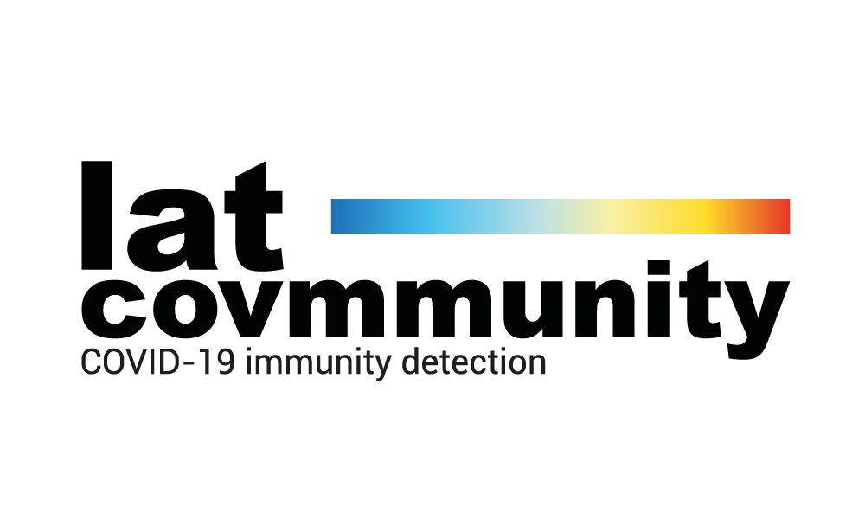
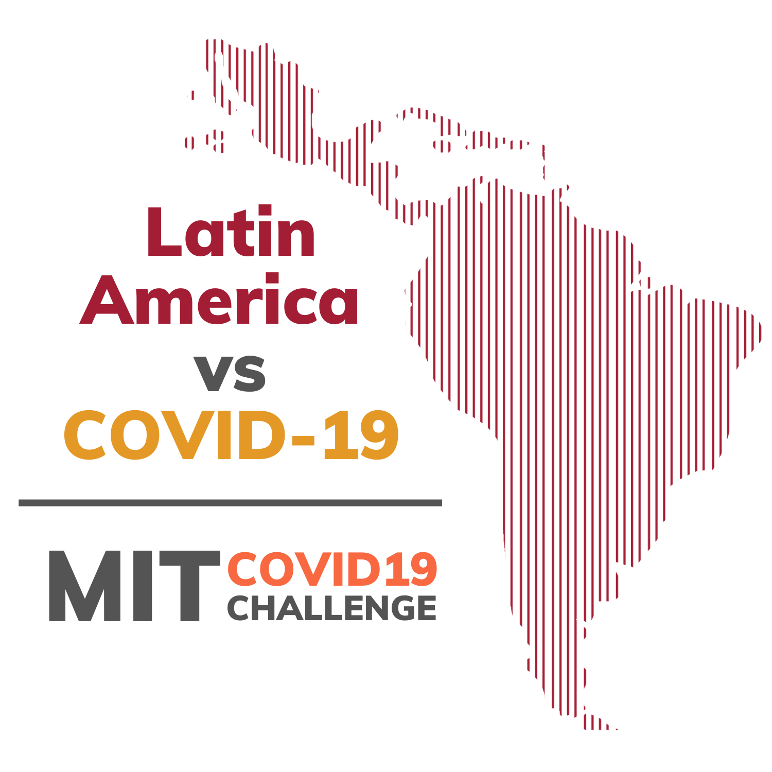
Winners of MIT COVID-19 challenge
Latin America vs. COVID
Track A. Identifying the Covid-19 Immune
Problem: Theres is no current effective protocol tu access
Solution: We develop a clinical protocol that recruits and
assesses immunity in recover COVID-19 patients
Participants:
Ariadna Gutiérrez de la Riva
Carlos Alberto Rodríguez Zerón
Dara Rubio Covarrubias
Humberto Alejandro Miranda Franco
Juan Manuel Ahumada
Tanya Sandeep Gupta
https://twitter.com/freddytn/status/1274803544932192261?s=20
https://twitter.com/MITvsCOVID19/status/1271515888492183552?s=20
https://covid19challenge.mit.edu/latam-vs-covid19/

Slide 17
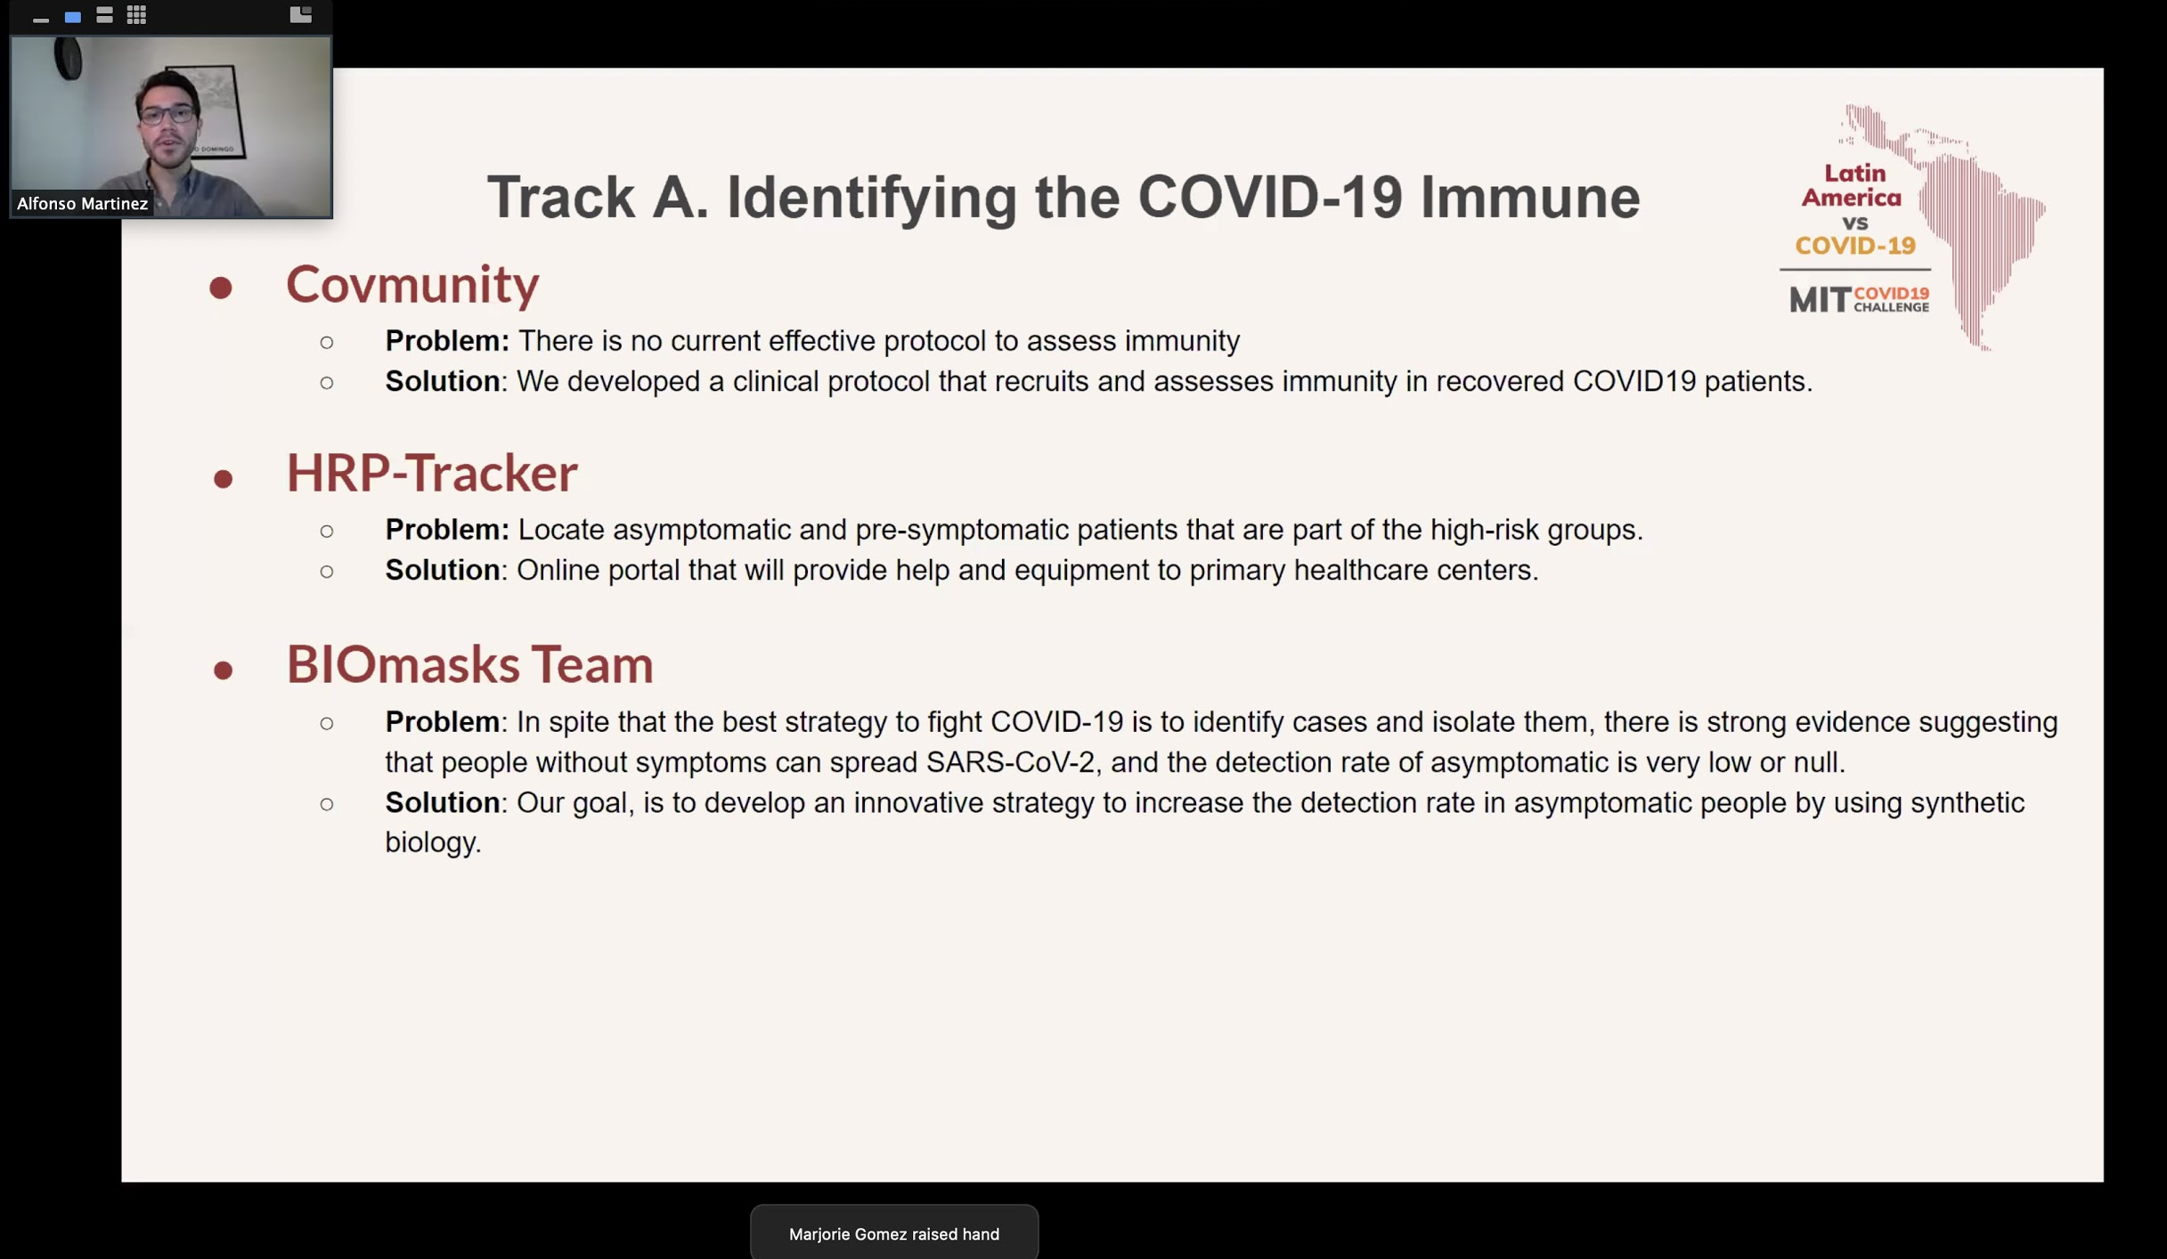

Slide 18
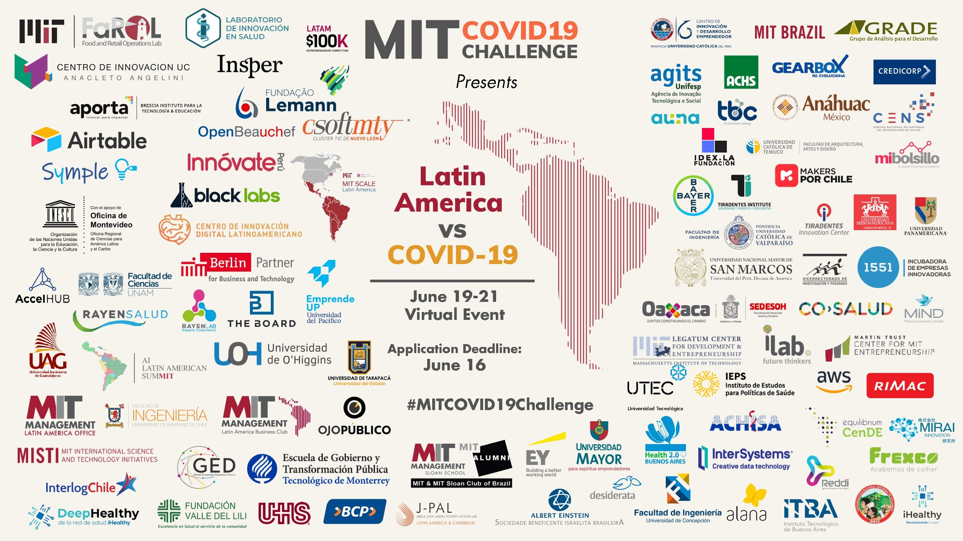

Slide 19
https://covid19challenge.mit.edu/latam-vs-covid19/
https://airtable.com/shrK9N4AslgnncNWO/tblIzOUqXVUKTHyXw
https://docs.google.com/presentation/d/e/2PACX-1vRK57vIMCnPgSD9RA4RZu3BNydi2mBymOiNJgyk7quwjnqOjmBGSbAr65CoPlKe_oDY4n18lTKfND65/pub?start=false&loop=false&delayms=3000&slide=id.p

